Slide 1
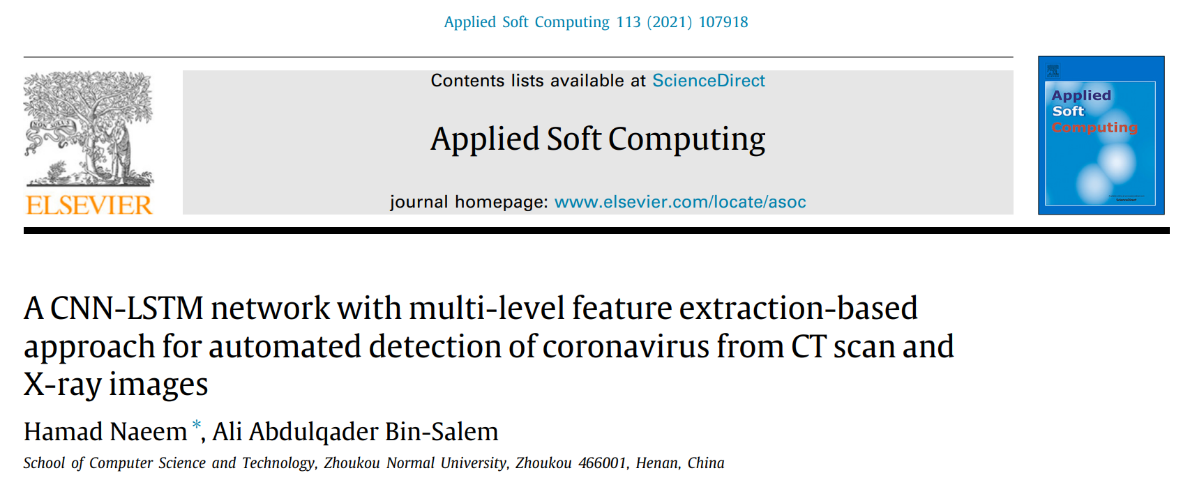
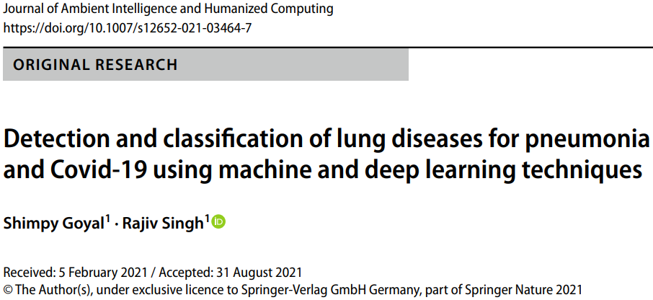

Slide 3
Background and Motivation
Automated detection and severity assessment of coronavirus from CT-scan and X-ray images;
Recent solutions (mostly are CNNs) are unable to determine the severity of Covid-19; inefficient for use by medical professionals;
Imbalanced Covid-19 dataset may yield to overfitting which reduces the performance of the model;
CNN models are expensive for medical solutions driven by ubiquitous computing.

Slide 4
Solution
A deep learning pipeline with multi-level feature extraction method that supports radiologist and doctors in examining chest CT-scans and X-rays for Covid-19;
Feature extraction method: GIST and SIFT (t-SNE) + CNN (automatic)
Deep learning: CNN + LSTM
Overfitting and imbalanced data: Dropout layer and SMOTE
Diagram in next slide.

Slide 5
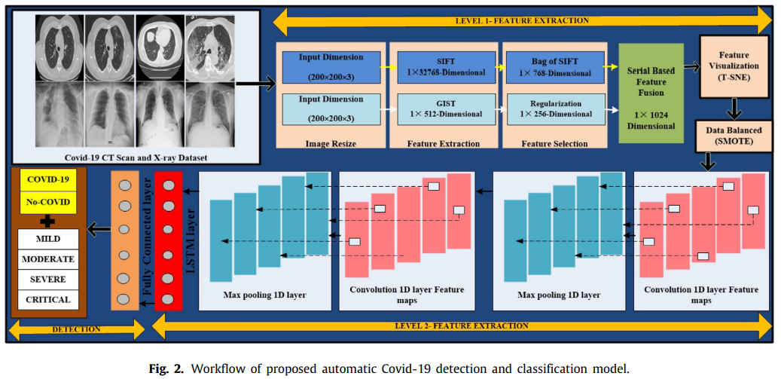
Solution

Slide 6
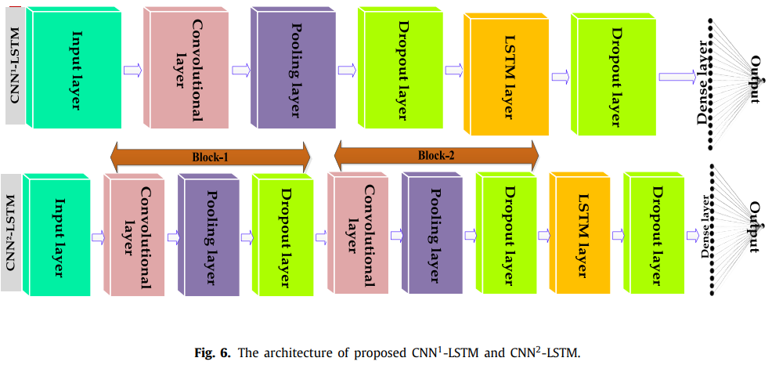
Solution
LSTM consist of one memory unit, input, forget, output gates.

Slide 7
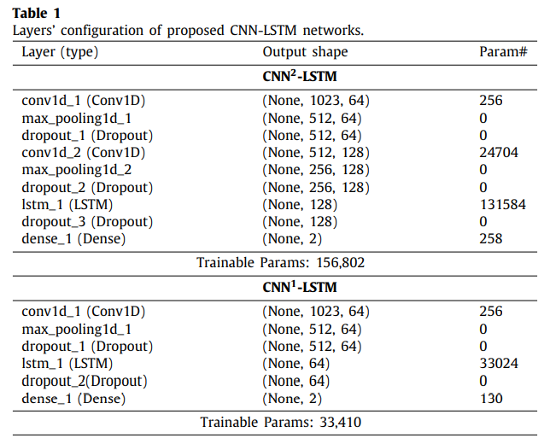
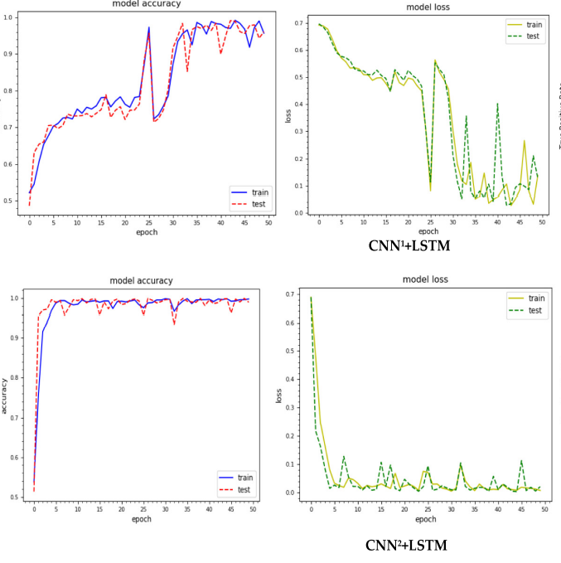
Results
Theoretically compare below params to minigooglenet or squeeze/mobilenet for appreciation.

Slide 8
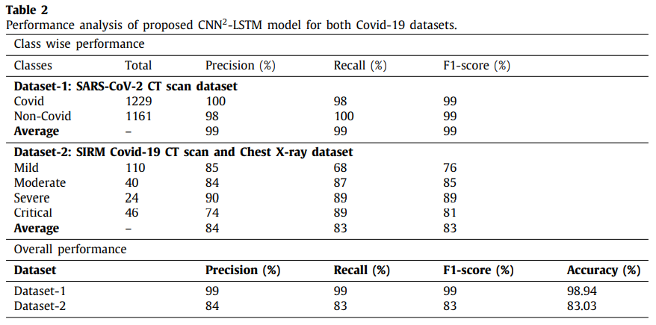
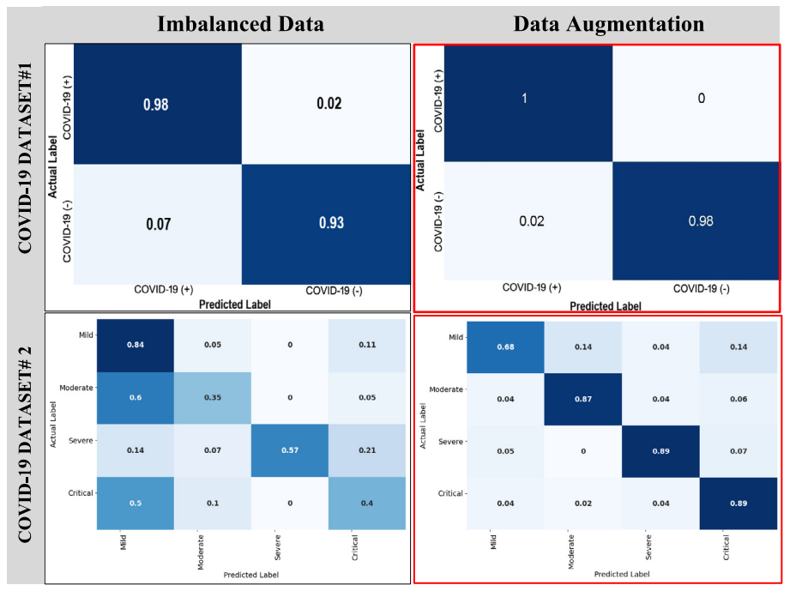
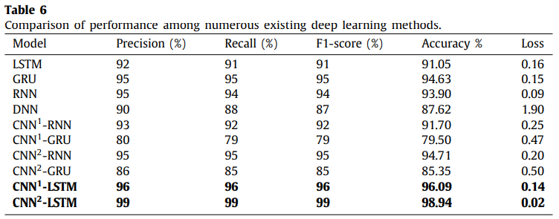
Results

Slide 10
Background and Motivation
Automated detection of lung diseases through X-ray – Covid-19, viral/bacterial pneumonia and differentiating each of these remain a challenge due to the lack of experiments on extensive relative datasets;
95% of CNN methods fail to discard unnecessary features;
<author’s argument>Training must be done mostly with infected features only to reduce complexities;
CNN is expensive;
Lack of sufficient medical data leads to unreliable feature extraction.

Slide 11
Solution
Uses F-RNN-LSTM for early detection of Covid-19, viral pneumonia, or bacterial pneumonia through chest X-ray;
X-ray image enhancement using median filtering, hist-eq., & intensity adjustment for ROI estimation and visualization with adaptive segmentation;
Use the normalized F(1:4) = [HOG texture invariant_moment ROI];
RNN-LSTM architecture
Comparison with SOTA MLAs
Diagrams in next slide.

Slide 12
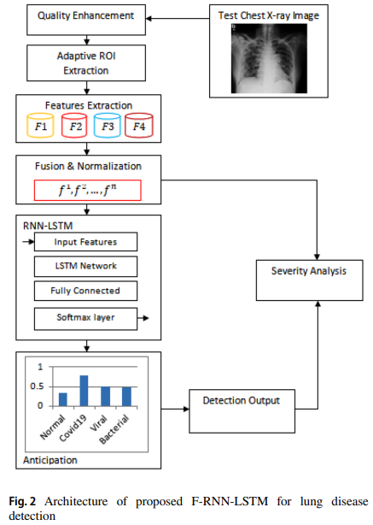
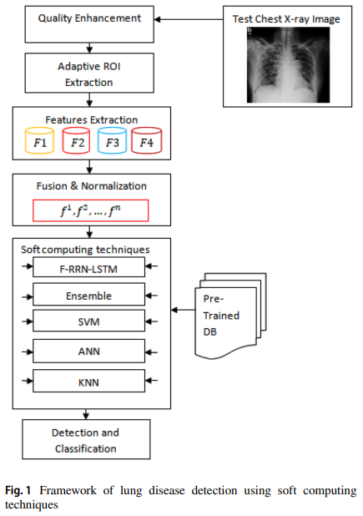
Solution

Slide 13
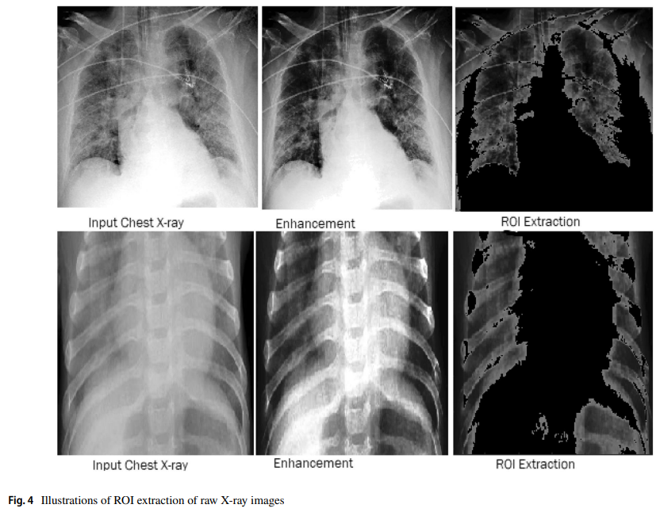
Solution

Slide 14
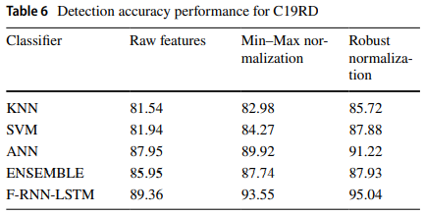
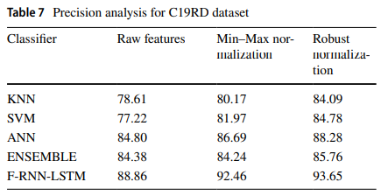
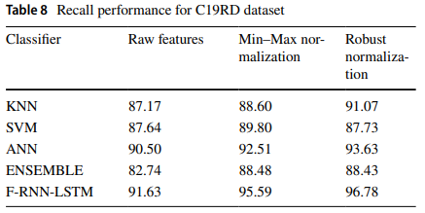
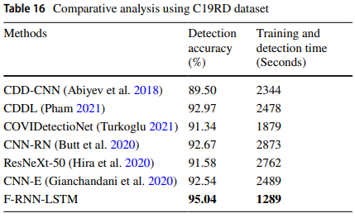
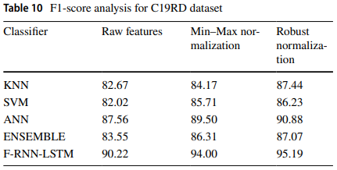
Results

Slide 15
ML challenge…
How can it be utilized for daily ubiquitous computing?
Miniaturization/tweaking of soft architectures aren’t enough, computing platforms must be considered (hardware—com.arch.)
NN in time-domain (Imp. of Fourier Transform in NN)...
As replacement for CNN and GAN…
Because they’re expensive…

